Slide 1
Moving Up! The transition to secondary school
Lesson series

Slide 2
Throughout our lives we experience lots of changes. For example starting a new school, moving house, going to university or starting a new job.
Change can affect us in different ways, we might feel excited or nervous.

Slide 3
We are now going to watch an animation
that shows four pupils starting secondary school.
As you watch, think about the problem each character has and how they solve them.

Slide 4
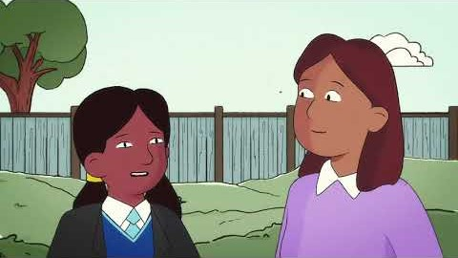

Slide 5
What were the characters worried about before they started secondary school?
Why were they worried?

Slide 6
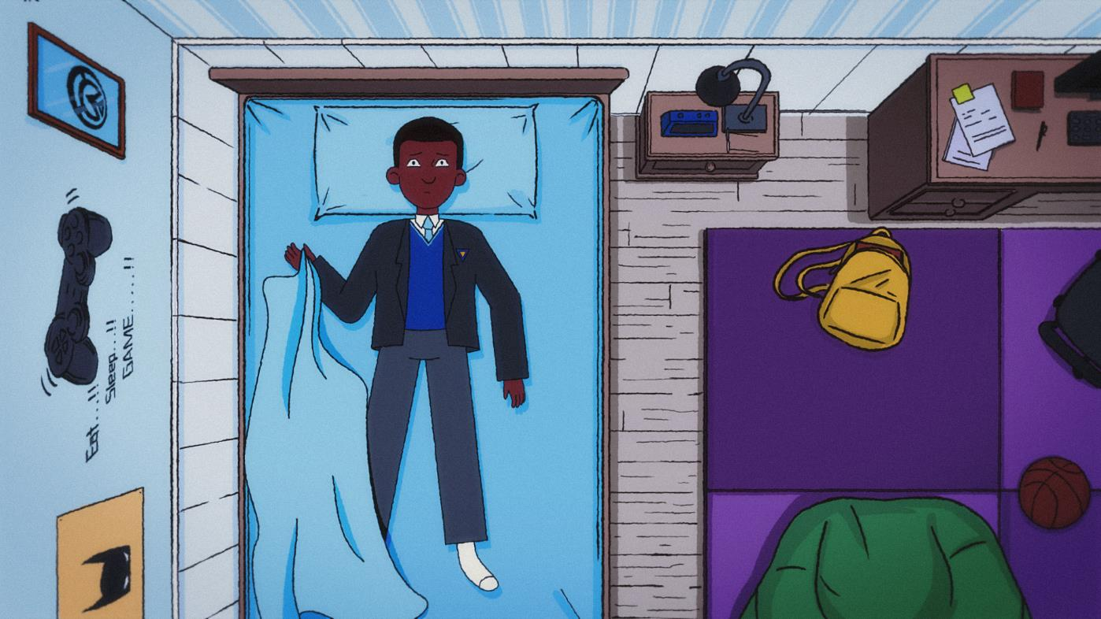

Slide 7
How did Albie, Alisha, Dele and
Eliza solve their problems?
engage
Notes:
10 mins

Slide 8
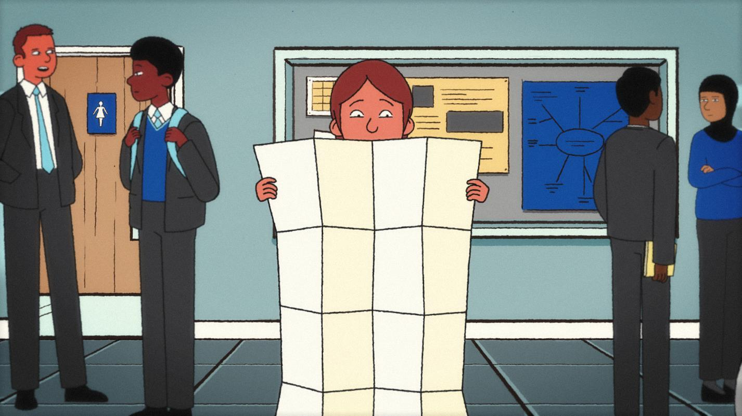
Notes:
Baseline assessment activity: This activity is an opportunity to assess pupils’ prior knowledge about friendships and relationships. It allows pupils to visualise their understanding before discussing formal concepts.
Explain to pupils that they will have 7 minutes to draw what a healthy friendship looks like to them. Reassure them that the focus is on their ideas, not artistic skill, so there’s no need to worry about making their drawing perfect. They can use symbols, colours, words, or any other way to represent key ideas.
Encourage pupils to think about:
how friends show kindness and support each other
the emotions involved in a healthy friendship
how friendships affect how we feel and our overall wellbeing?
how friends communicate and resolve disagreements.
At the end of the timer, ask students to turn over their paper. Explain that they will revisit their drawing at the end of the session to add anything new they have learned.
Differentiation: support and challenge ideas
Support:
provide sentence starters e.g., a good friend is someone who…
offer a work bank of friendship qualities they can use (kindness, trust, respect)
Challenge:
add speech bubbles to show how friends communicate

Slide 9
It’s important to think about self-care, as self-care can help us to feel better if we’re feeling down, and can help keep us feeling good. It’s a great way to look after our own mental health and wellbeing.
Notes:
Read the learning outcome aloud or ask a pupil to, so everyone knows the focus of the activity.

Slide 10
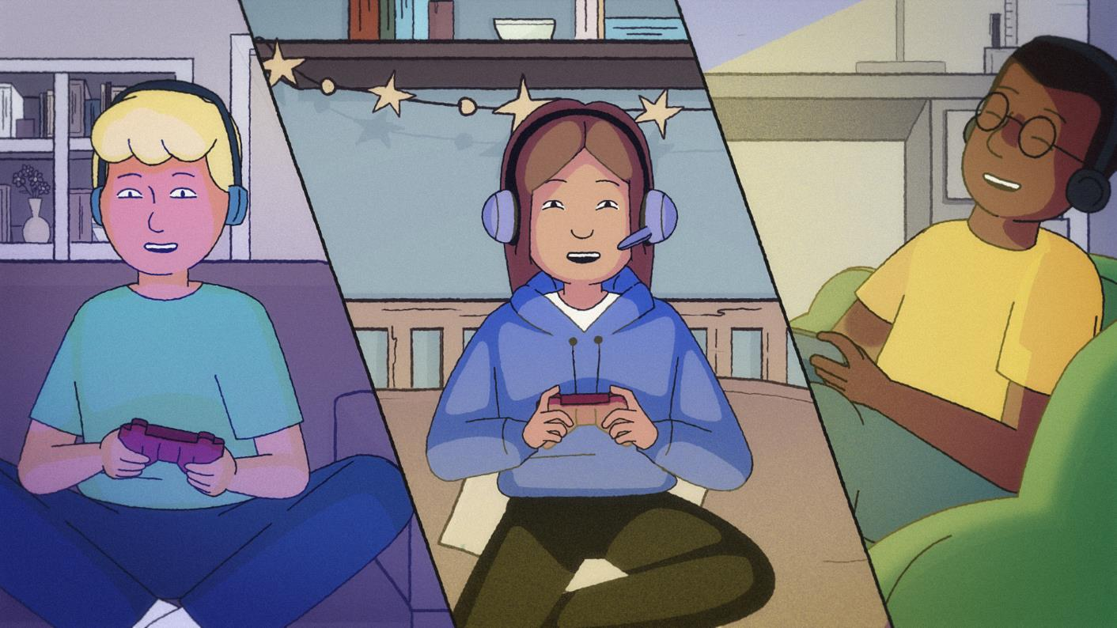
Notes:
Baseline assessment activity: This activity is an opportunity to assess pupils’ prior knowledge about friendships and relationships. It allows pupils to visualise their understanding before discussing formal concepts.
Explain to pupils that they will have 7 minutes to draw what a healthy friendship looks like to them. Reassure them that the focus is on their ideas, not artistic skill, so there’s no need to worry about making their drawing perfect. They can use symbols, colours, words, or any other way to represent key ideas.
Encourage pupils to think about:
how friends show kindness and support each other
the emotions involved in a healthy friendship
how friendships affect how we feel and our overall wellbeing?
how friends communicate and resolve disagreements.
At the end of the timer, ask students to turn over their paper. Explain that they will revisit their drawing at the end of the session to add anything new they have learned.
Differentiation: support and challenge ideas
Support:
provide sentence starters e.g., a good friend is someone who…
offer a work bank of friendship qualities they can use (kindness, trust, respect)
Challenge:
add speech bubbles to show how friends communicate

Slide 11
Why is it good to tell someone when you are worried about something?
Who could you speak to in school if you are worried?
Notes:
10 mins

Slide 12
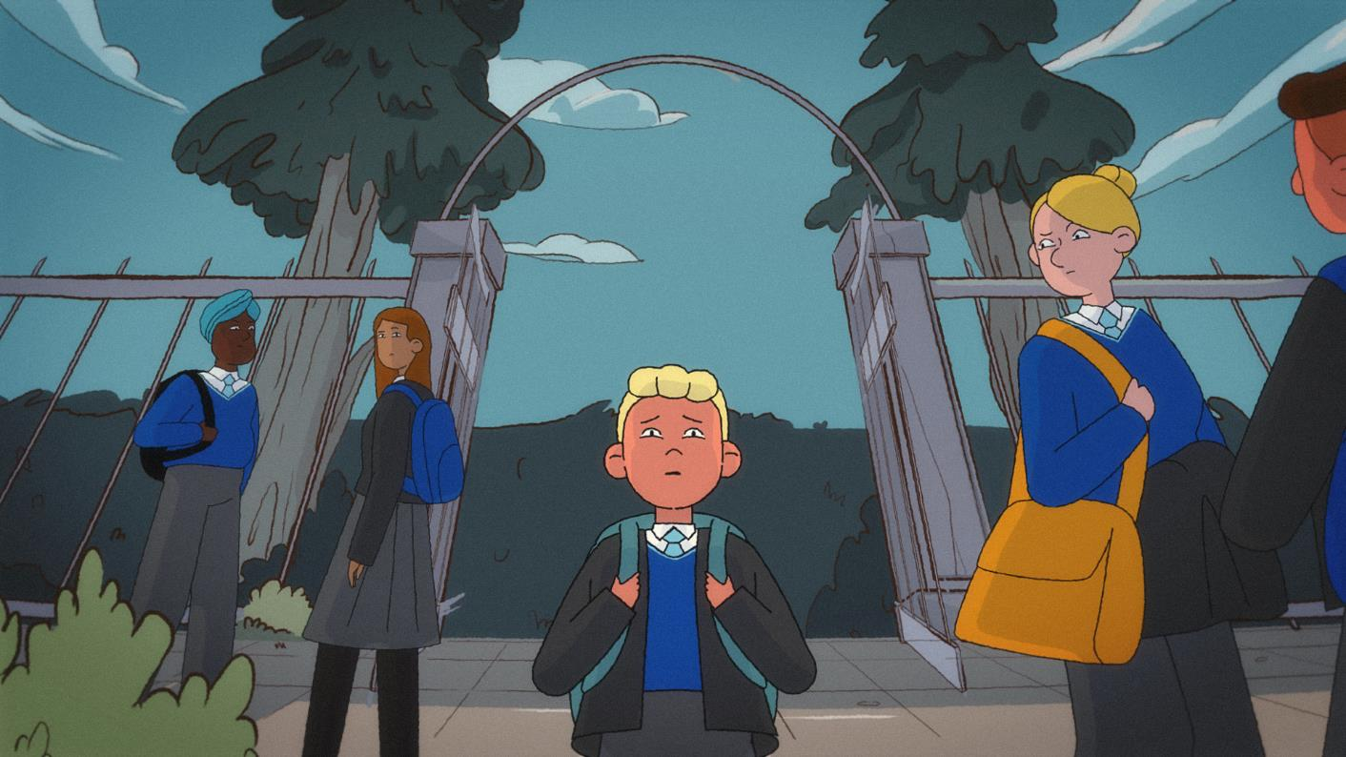
Notes:
Baseline assessment activity: This activity is an opportunity to assess pupils’ prior knowledge about friendships and relationships. It allows pupils to visualise their understanding before discussing formal concepts.
Explain to pupils that they will have 7 minutes to draw what a healthy friendship looks like to them. Reassure them that the focus is on their ideas, not artistic skill, so there’s no need to worry about making their drawing perfect. They can use symbols, colours, words, or any other way to represent key ideas.
Encourage pupils to think about:
how friends show kindness and support each other
the emotions involved in a healthy friendship
how friendships affect how we feel and our overall wellbeing?
how friends communicate and resolve disagreements.
At the end of the timer, ask students to turn over their paper. Explain that they will revisit their drawing at the end of the session to add anything new they have learned.
Differentiation: support and challenge ideas
Support:
provide sentence starters e.g., a good friend is someone who…
offer a work bank of friendship qualities they can use (kindness, trust, respect)
Challenge:
add speech bubbles to show how friends communicate

Slide 13
In school you can talk to…
[Insert support options at your school]
Notes:
This slide is an opportunity to embed the learning from the assembly and may be used to support differentiation.
Play 'Word match ' to answer the questions. Animated slide, questions to appear on click.
How to play 'Word match’:
pupils work in pairs or small groups
one pupil says a word or phrase that describes the sentence shared, and their partner responds with another related word or phrase
they continue back and forth, building on each other’s ideas.
E.g. What does a healthy relationship look like?
A) happy people
B) comfortable
A) feeling safe
B) trusting each other
Alternative approach: If preferred, the class can discuss the questions together instead.

Slide 14
Other places
On My Mind – www.annafreud.org/on-my-mind/
Youth Wellbeing Directory – www.annafreud.org/on-my-mind/youth-wellbeing/
Self Care pages - https://www.annafreud.org/on-my-mind/self-care/
Urgent Help – https://www.annafreud.org/on-my-mind/urgent-help/
Anna Freud Centre – www.annafreud.org/
[Optional: insert any other organisations in your local area where young people can find support]
Notes:
This slide is an opportunity to embed the learning from the assembly and may be used to support differentiation.
Play 'Word match ' to answer the questions. Animated slide, questions to appear on click.
How to play 'Word match’:
pupils work in pairs or small groups
one pupil says a word or phrase that describes the sentence shared, and their partner responds with another related word or phrase
they continue back and forth, building on each other’s ideas.
E.g. What does a healthy relationship look like?
A) happy people
B) comfortable
A) feeling safe
B) trusting each other
Alternative approach: If preferred, the class can discuss the questions together instead.

