Slide 1

Trauma informed approach.
Willow Grove Primary School

Slide 2
Trauma informed approach.
We are proud to be a trauma informed school. This presentation is to offer an insight into what we do at Willow Grove to support anyone who has experienced trauma.
At our school, we know that some children may have experienced difficult or upsetting events in their lives. These experiences can affect how they feel, behave, and learn.
Being a trauma-informed school means we understand this and work together to create a place where every child feels safe, supported, and valued.
💖 We Create a Safe and Caring Environment
🧠 We Understand and Support Emotional Needs
🌈 We Help Children Regulate and Reconnect
🤝 We Work Together with Families and the Community
🧩 We Care for Our Staff Too and support parents and carers
🌟 Our Goal
To create a calm, caring, and inclusive school where every child feels seen, heard, and ready to learn.

Slide 3


What is trauma?
Trauma is a response to an overwhelming or a scary event, and a person’s brain and body don’t feel safe or able to handle it.
It’s not just about what happened — it’s about how the person’s brain and body reacted to what happened.
For example, two people might go through the same event, but one might recover quickly, while the other might carry fear or worry for a long time afterwards.

Slide 4
The Three R’s of Trauma-Informed Care
Realising
the level of trauma
Recognising
how trauma affects the individual
Responding
by offering support

Slide 5

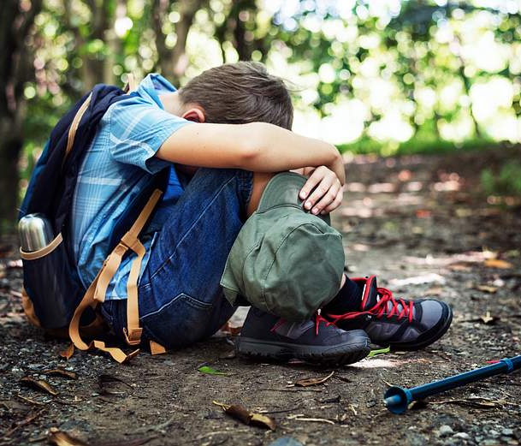



Understanding Trauma

Slide 6
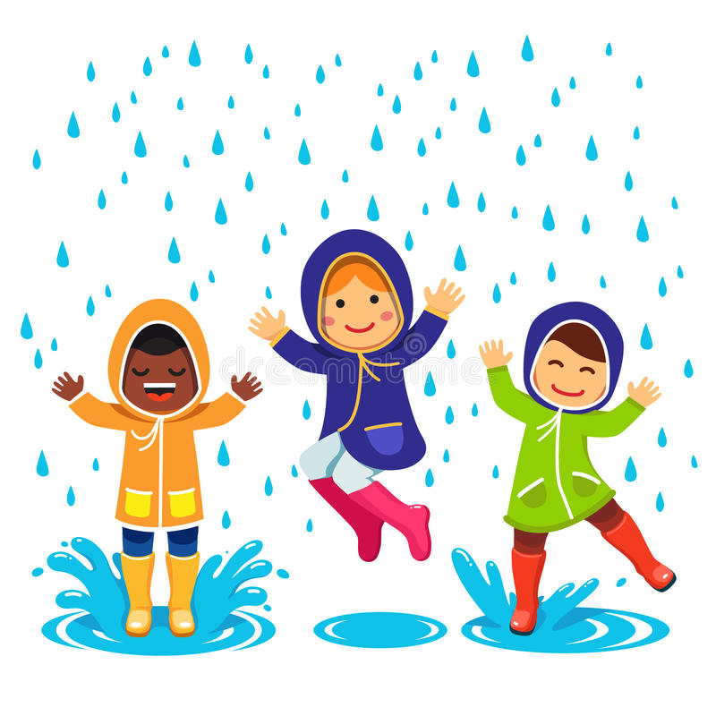
Traumatic Stress Response
A traumatic stress response occurs when our ability to respond to the threat is overwhelmed
At Willow Grove our staff are committed in offering a trauma informed approach to support children to deal with issues that have arisen from previous trauma and adopt coping strategies.

Slide 7
Trauma & Toxic Stress
Below are some of the underlying causes of trauma. Children may face one or more of these in their lifetime.
Complex Trauma
Abuse
Toxic Stress
Racism
Trauma
Accidents
Discrimination
Community Violence
Poverty
Being different
Severe neglect
Domestic violence
Abandonment
Natural/Manmade Disaster
Serious illness

Slide 8
Impact on world view
Beliefs children often have following trauma:
I am not safe
I cannot trust others
I cannot trust myself
I cannot depend upon others
I am not worthy of care
I deserve the bad things that happen to me
It’s my fault

Slide 9

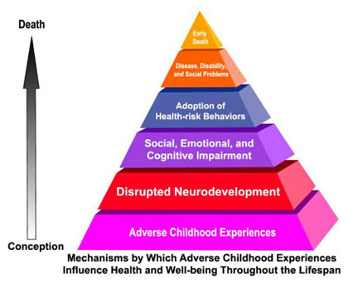

Adverse Childhood Experiences (ACES)
What is an ACE? We have faced different challenges during childhood. The more adverse challenges we face, the greater the risk of us facing challenges in our adult lives.
Examples of ACES
Recurrent physical abuse
Emotional abuse
Sexual abuse
Alcohol/drug abuser in household
Incarcerated house-hold member
Household member with chronic mental illness
Violence between adults in the home
Parental separation or divorce
Services,
support & resilience
can change this life course

Slide 10

ACES and Health & Social Problems
Research shows that there are significant risks to children who do not get support following trauma.
COPD
Ischemic heart disease
Any cancer
Stroke
Diabetes
STDs
Depression
Suicide attempt
Alcohol abuse
Illicit drug use
Risk for intimate partner violence
Multiple sexual partners
Smoking
Unintended pregnancies
Early initiation of smoking
Early initiation of sexual activity
Adolescent pregnancy

Slide 11
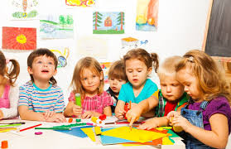
ACES and School Performance
Students dealing with trauma are more likely to:
Find learning difficult
Make slower academic progress
Have more receptive & expressive language difficulties
Face exclusions
Require access to special education

Slide 12
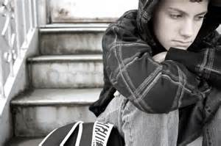
The Impact of Trauma on Survivors

Slide 13
Fight, Flight, Freeze
FIGHT
If trauma surfaces, fight mode can be triggered.
This can be shown in the form of rage or extreme sadness.
Flight
If a child feels traumatised, they may be compelled to flee from the situation to reach safety.
FREEZE
The effects of trauma can sometimes lead to Freeze
mode in which the child feels unable to move due to
extreme feelings of fear.

Slide 14

Impact of Trauma
Children are often very confused about what has happened to them and find it difficult to make sense of their feelings following trauma. This affects their ability to rationalise how they are feeling and use the thinking part of their brain to decide upon how to cope. Instead the emotional or instinctive parts of the brain are used which results in behaviours a child may not usually display.
Thinking
Brain
Emotional
Brain
Instinctive
Brain

Slide 15
Common Post-traumatic Triggers
These are some of the things that may heighten a child's emotions following trauma.
Therapy & therapists
Being asked questions
Self-disclosure
Being put on the spot
Being center of attention
Loud noises
Authority figures
Being told “No”
Males/females
Criticism, feedback
Home/family
Eye Contact
Recall of traumatic event
Anniversaries
Not allowed to speak
Being ignored
Emotions, vulnerability
Unfamiliar stimuli
Demands/being asked to do something
Having to say “Yes”
Night time, sleep
Confrontation
Intimacy
Commitment

Slide 16
Survival Response
This explains in more detail responses to trauma.
Fight
Individual struggles to regain or hold on to power, especially when feeling coerced
Mislabeled as: Non-compliant or angry
Flight
Individual disengages, or “check outs” emotionally
Mislabeled as: Uncooperative or resistant
Freeze
Individual gives in to those in positions of power, does not or is unable to speak up
Mislabeled as: Passive or unmotivated
Intervention is needed to support the child.

Slide 17
Core Values of Trauma-
Informed Care
Traumatised children need:
Safety: reminding a child they are safe promotes a sense of safety and aids healing
Trustworthiness: Children need a predictable environment , with tasks made clear, and appropriate boundaries
Empathise: actively listening, validating feelings and showing understanding to help the child to feel seen and heard.
Calm: displaying the behaviour you would like from the child will help them to model their behaviour on yours
Space: traumatised children benefit from some time to process their thoughts in a quiet place and feel safe to do so
Follow through on commitments: as trusted adults, it is important that we do what we say we will do. Children gain comfort from this predictability and build deeper levels of trust

Slide 18

Contact Information
Useful websites offering guidance for parents and carers
Trauma Resources for Families
Addressing trauma and adversity | Resources | YoungMinds
If you have any questions or concerns around trauma informed approaches, please contact
Mrs Latham s.latham@willowgroveprimary.org.uk
Miss Threlfall c.threlfall@willowgroveprimary.org.uk

