Slide 1

An Attachment & Trauma Responsive School
WILLOW GROVE PRIMARY SCHOOL
Be Safe, Be Kind, Be Positive

Slide 2
An Attachment & Trauma Responsive School
Attachment & Trauma Awareness – why?
Emotion coaching
How we manage Emotional Dysregulation in the Classroom

Slide 3

Attachment & Trauma Awareness

Slide 4

https://www.youtube.com/watch?v=uMbhB2l4ut0

Slide 5
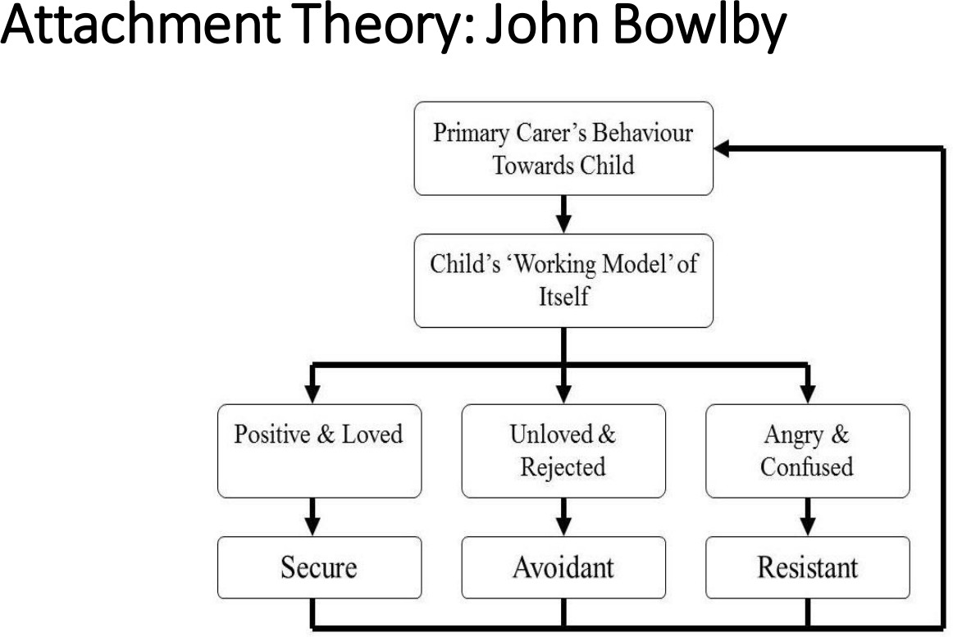

Slide 6
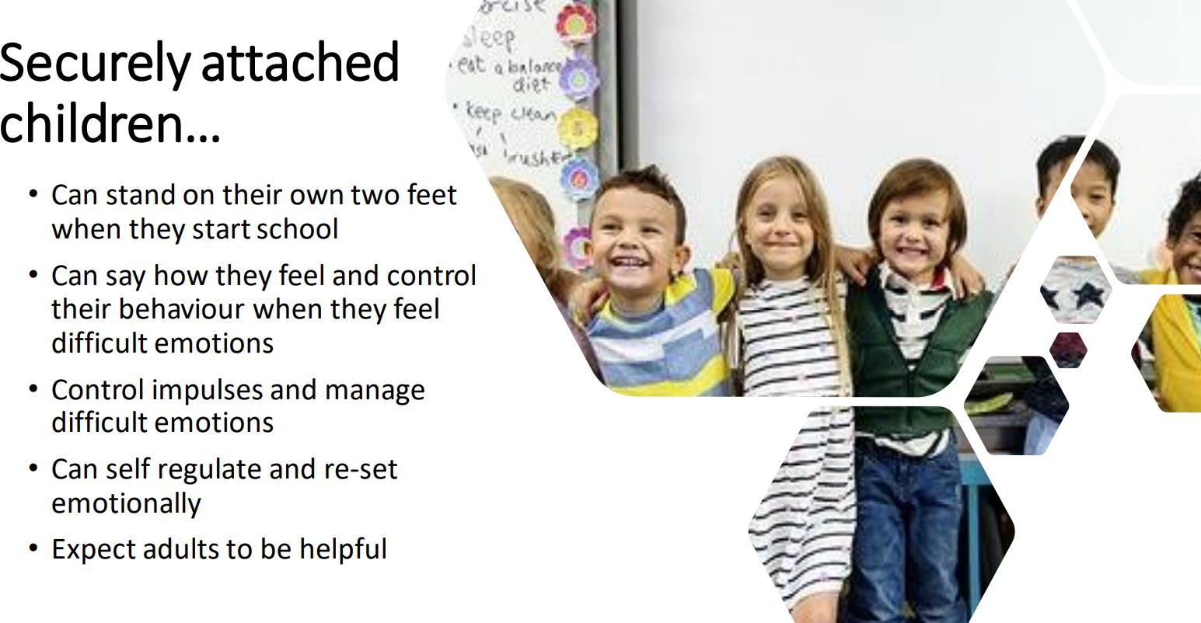

Slide 7
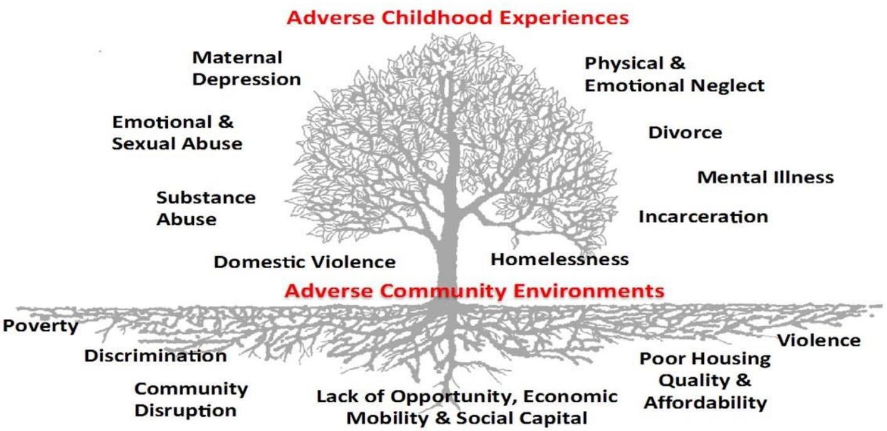

Slide 8
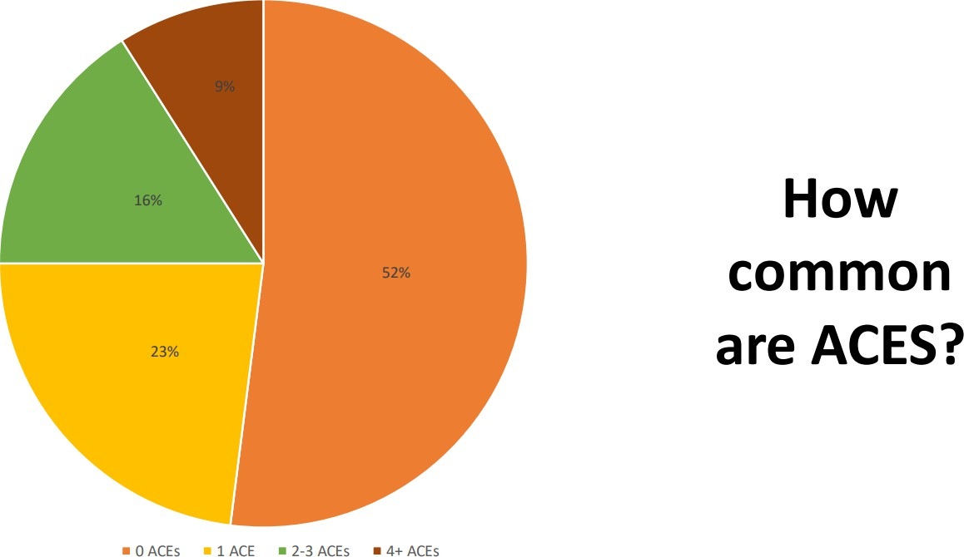

Slide 9
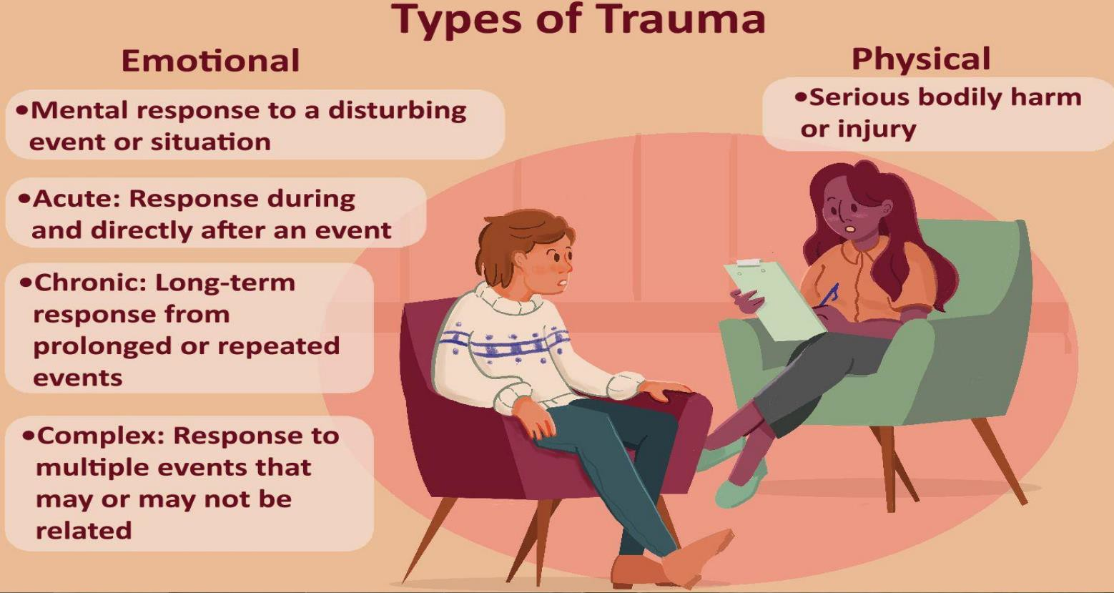

Slide 10
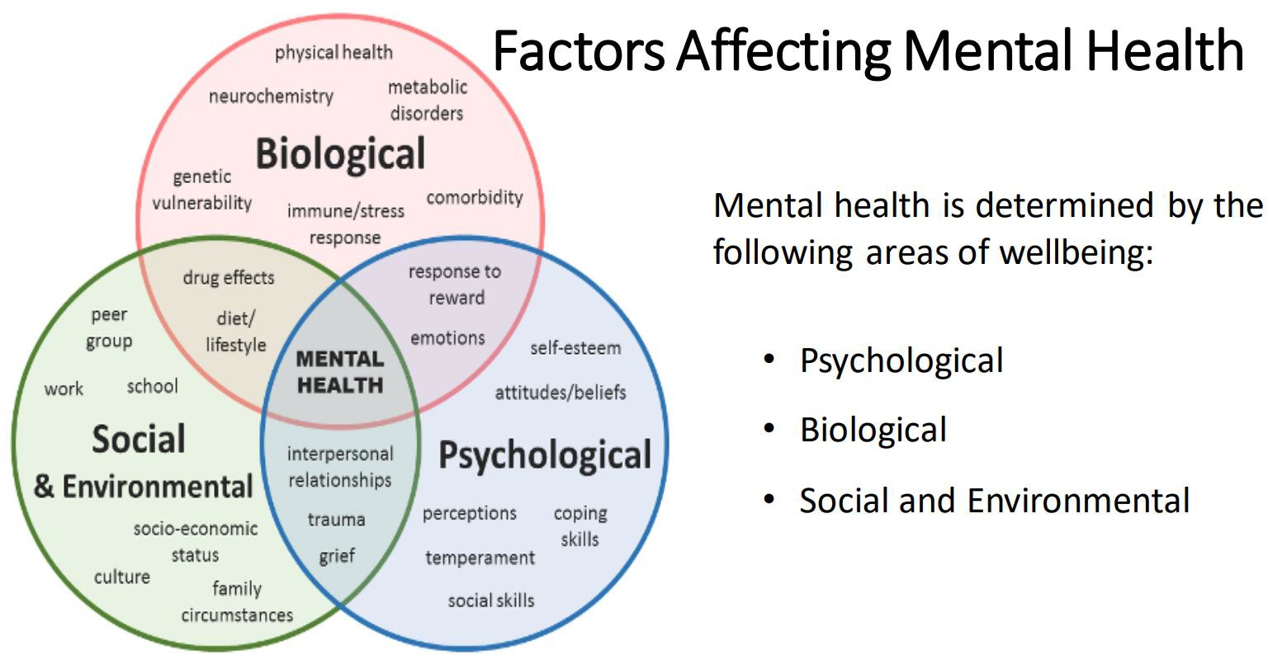

Slide 11
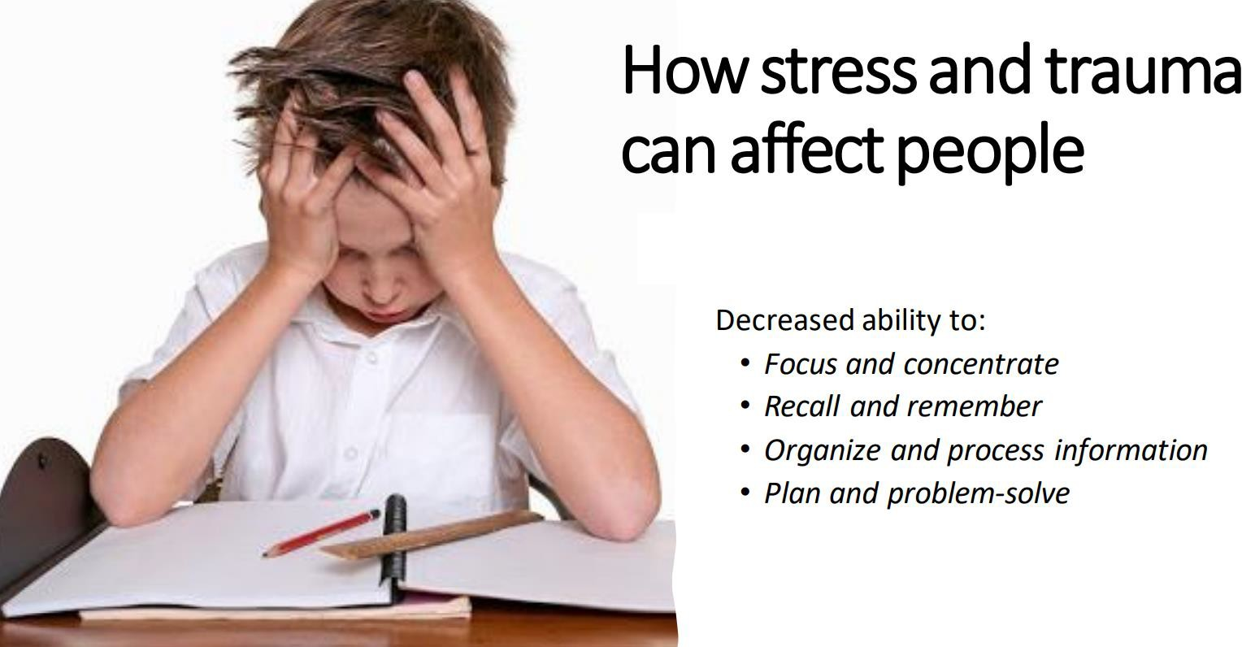

Slide 12
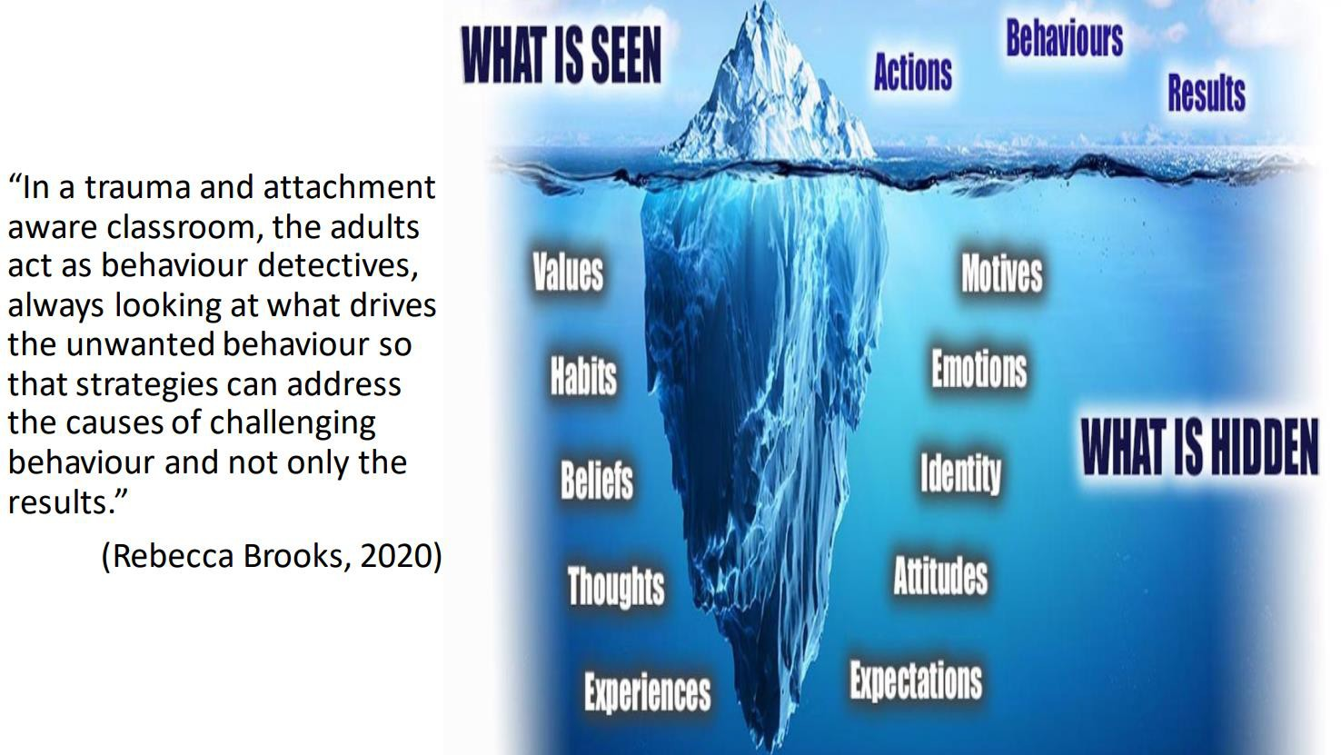

Slide 13






How do we deal with our own trauma?
How do we deal with our own trauma?

Slide 14

How we manage emotional dysregulation in the classroom

Slide 15


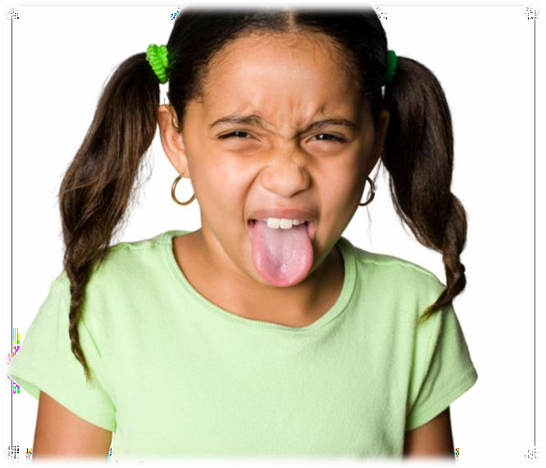



Six basic emotions – can you recognise them?

Slide 16

Emotional Dysregulation In Children
Signs of emotional dysregulation in children may include feeling impatient, becoming very upset or angry when demands are placed on them, and having other types of outbursts without consistency and structure.
Children learn emotional regulation skills from their parents, so if their parents struggle or have mental health issues that are not being treated or managed, children may develop dysregulation as a response to their environment.
It’s important children feel safe and are allowed to display their emotions and learn how to manage them from a place of compassion, not punishment.

Slide 17
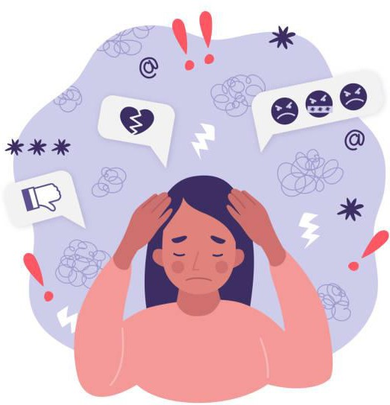
Emotional Dysregulation Symptoms
The main symptoms of emotional dysregulation are intense emotional reactions and poor
management of emotions. These emotions can be anything from sadness to anger or irritation.
Feelings are also exacerbated for those dealing with emotional dysregulation and may appear to be exaggerated. Emotional dysregulation symptoms may include:
Intense emotional reactions compared to the situation that triggered them
Not being able to calm down
Having negative thoughts
Feeling out of control
Difficulty coping in a healthy way
Severe depression
Disordered eating
Conflicted personal relationships
Feeling confused by emotions
Anxiety
Substance abuse
Self-harm behaviours and thoughts
High risk sexual behaviours
High conflict relationships

Slide 18
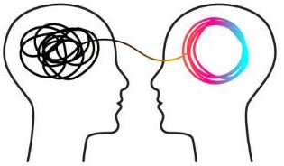
Adults can help
Helping children to realise what they’re feeling is really important.
In the early stages, we help children to understand what they are feeling and to control it. This is called “Co-regulation” because we’re working in partnership with children.
As children grow up we want them to be able to “self-regulate” their emotions. This means that they can control their emotions in social situations such as at school and at work.
Emotion Coaching is a way of doing this

Slide 19
Strategies we use to support Emotional Regulation
Expecting our children to be able to recognise when their emotions are heightening is a big ask.
Asking them to stop and to calm themselves down again is an even bigger one! So, how can we help them get on the path to regulating their emotions?
“When a child can’t calm down, they need connection and comfort, not criticism and control.”
Jane Evans (Early Childhood Trauma & Anxiety)
Showing empathy is the first step to connecting with them when they’re emotionally heightened.
Showing children that we have time for and respect their feelings helps them to feel open, safe and supported. Regardless of how unreasonable their feelings are, that’s how they’re feeling!
Discussions about whether their reaction was warranted or not can come once they have calmed down enough to think logically (reasoning).
Once they feel a connection with us in their emotional state, they will be open to our directions and strategies (co-regulation).

Slide 20
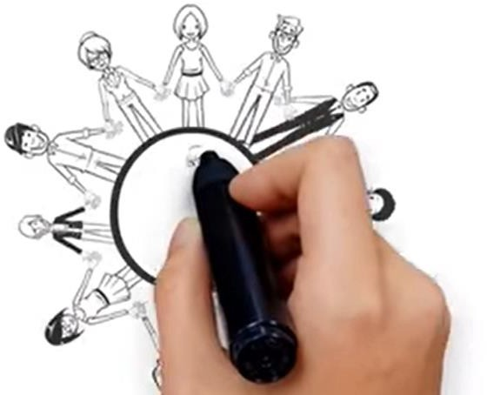
A trusted adult makes connections with pupils
Supports them to feel safe and manage their feelings
Strengthens relationships
Increases understanding and empathy
Adult connects with the child’s emotions rather than judging the child’s reasons for feeling this way
Connecting with the child before correcting the behaviour
Recognise Relate Regulate Reason

Slide 21

Losing control of our emotions
Click here for
video

Slide 22
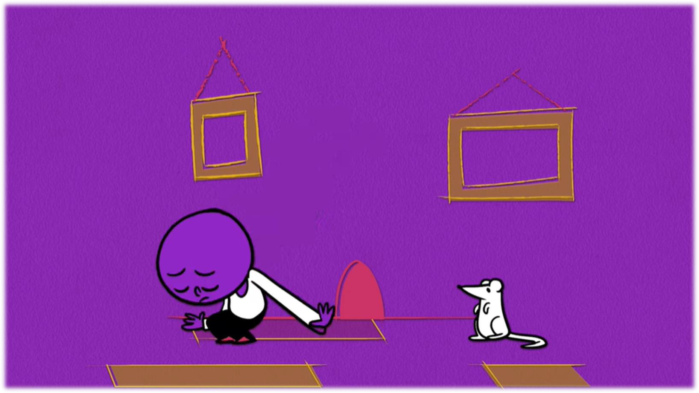
Child-friendly explanation…
Click here for video

Slide 23
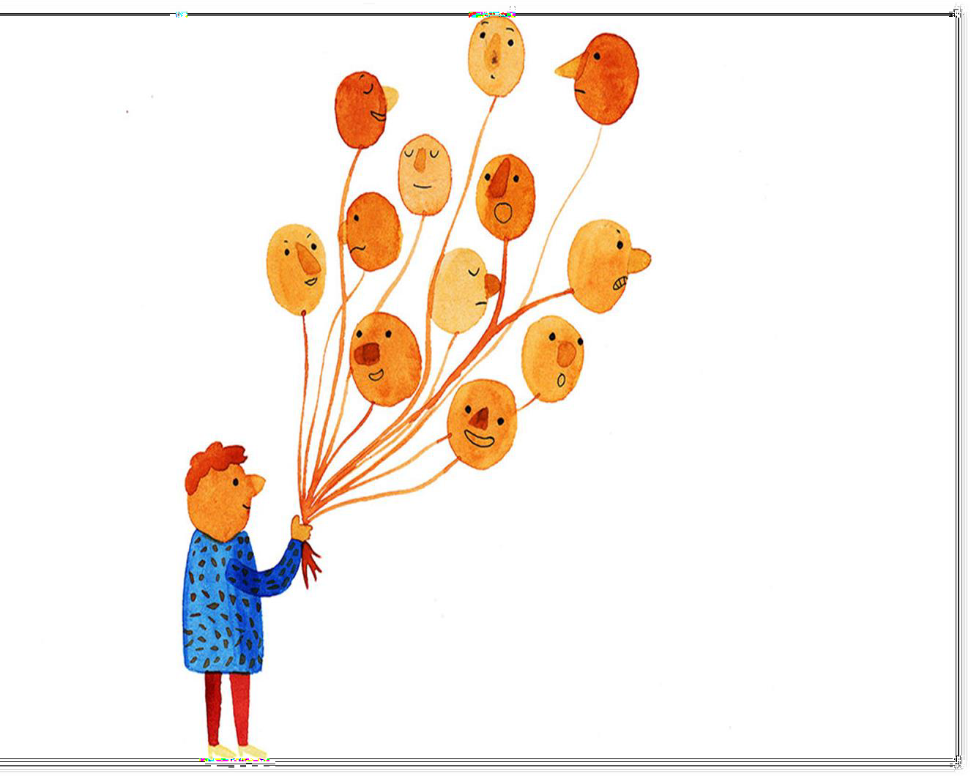



Slide 24
Recognise Regulate Relate Reason
(Dr Bruce Perry 2017)

Slide 25
Notice the child’s behaviour and tune in to the emotion beneath (recognise)
Connect with the child and recognise emotional times as opportunities for intimacy and teaching (regulate)
Listen empathetically and validate the child’s feelings, helping them to verbally label their emotions (relate)
Set limits on the child’s behaviour whilst helping them to problem-solve (reason)

Slide 26





Step 1 – in the moment
recognise & regulate
Recognise all emotions as being natural and normal and not always a matter of choice
Recognise behaviour as communication – what is your child trying to say?
Look for physical and verbal signs of the emotion being felt – are they hot, red, shaking, quiet, crying, curled up?
Take on the child’s perspective – try to put yourself in their shoes
Affirm and empathise. Show that you’re listening and understand.
Things we say
“I’m sorry that happened to you, you must feel angry/very annoyed”
“I think I’d feel annoyed if that happened to
me”
I would feel angry too”
“It’s normal to feel angry about that”
“It’s ok to feel upset by what happened”
“I understand why you’re sad”
“I’d feel sad if that happened to me”

Slide 27

Step 2 – in the moment
relate
Things we say -
“You look angry to me”
“I wonder if you’re feeling sad”
“I can tell you’re feeling…..”
“I can see that has made you feel…”
“It sounds like you are feeling…”
Validate the emotion and acknowledge its existence
Use words to reflect back child’s emotion – help them to understand what they’re feeling
Help your child to label or name the emotion
Talk them through what you think they may be feeling.

Slide 28

Step 3 – later when your child is calm
reason
Setting limits (If needed) What we say
“…..it’s not ok to behave like that.”
“….we can’t allow that to happen.”
“…doing that is not ok.”
“….that behaviour is not acceptable.”
Safety first
State the boundary limits of acceptable behaviour - explain hitting, snatching, rude words are not ok.
Make it clear certain behaviours cannot be accepted
But retain the child’s self-dignity – don’t make them feel small or bad.
“…even when we’re angry, it’s not ok to hit someone.”

Slide 29
Step 4 – when your child is calm
reason
Problem-solving with the child
When your child is calm and in a relaxed, rational state:
Explore the feelings that gave rise to the
behavior/problem/incident
Help them to think of other ways they could have handled it
Help your child to believe s/he can overcome difficulties and manage feelings/behaviour
Things we say
“How were you feeling when that happened”
“Let’s think of what you could have done instead”
“Try and do this next time you feel like that.”

Slide 30
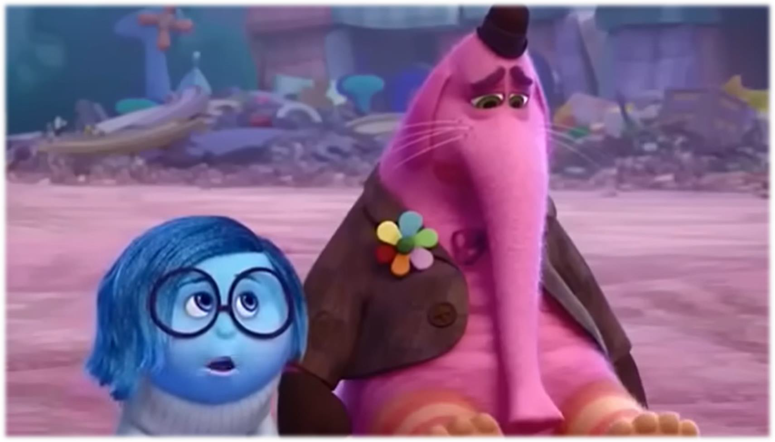
Emotion coaching - not emotion dismissing…
Click here

Slide 31
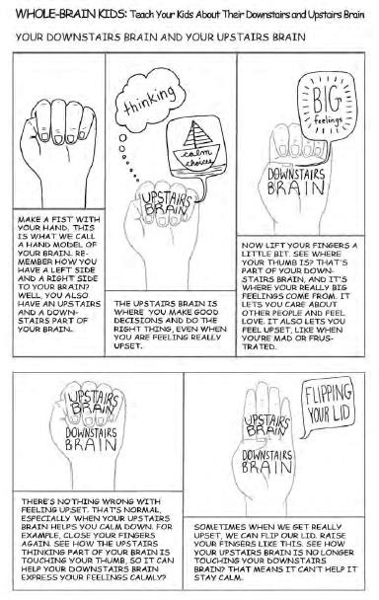

https://theresponsivecounselor.com/2021/06/teaching-kids- about-flipping-their-lids.html

